Slide 1


The CAIA Association
CAIA LEVEL I
Candidate Orientation
March 2023 Exam
The Global Professional Body for Alternative Investment Education
Notes:
After hitting “Broadcast”: Slowly…Thank you all for joining. As people are continuing to come into the webinar we will be starting very soon. We are excited to have you with us today for what we hope will be a very informative session....(talk slowly and then say again)...We will be starting the event very soon, many are still coming into the webinar.
Hello Everyone, thank you for joining the CAIA Level I Candidate Orientation session for the Sept 2021 exams today. We have a great turn out and it is my hope that everyone can participate for the full hour. My name is Kathy Lyons and I am the Sr. Candidate Relations Manager here at the CAIA Association. This session is being recorded and will be available on our website within a week or so.
I would like to introduce our presenters today Keith Black who is our Managing Director of Content Strategy, who will be leading us through a presentation focused on the topics covered in the March 2021 Level I exam and will share studying tips to help you with your studying efforts. Sarah Auerbach, who is our Director of Candidate and Member Relations will be reviewing online proctoring information.
I will be assisting later in the presentation, as I relay some typical procedures and policies Candidates should be aware of for a smooth experience leading up to and on exam day. If you have questions you think of in advance, you are welcome to enter your questions in the Q & A panel to the bottom right of your screen. You must be typing in the text box for us to see your question. Please do not use the “Chat feature” as we cannot see questions typed there. But first I’d like to introduce William Kelly, CEO of the CAIA Association who would like to kick off the meeting with a few words. With that, I will now turn it over to Bill.

Slide 2
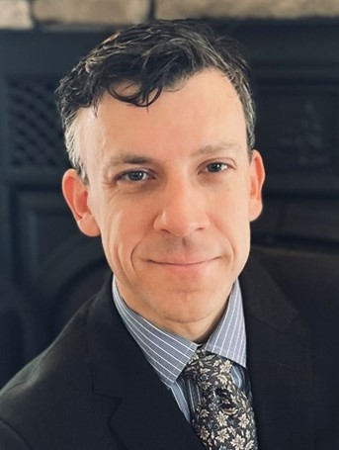


Today’s Presenters
Steve Novakovic
Managing Director, CAIA Curriculum
CAIA Association
Aleeza Amador
Candidate Relations Associate
CAIA Association
Kathy Lyons
Sr. Candidate Relations Manager
CAIA Association
¡Yo hablo español!
Part I
Exam Experience
Part II
Candidate Experience

Slide 3





Digital Learning Platform
Discover the essential guide containing all the tools, content, and terminology you need to pass the Chartered Alternative Investment Analyst® exams.
Handy features - Highlight content, create custom notes, pace your study time, take self-assessments, communicate with other Candidates, and much more!
Available ONLY through Wiley Efficient Learning
Accessible for 18 months from date of purchase with automatic updates as released
Digital environment incorporates almost all learning content, including the full curriculum, study guide, workbook, and additional readings into one platform.

Slide 4
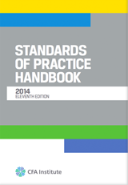
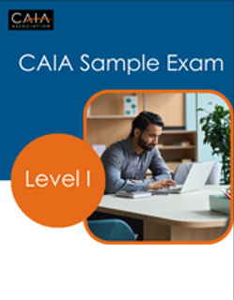
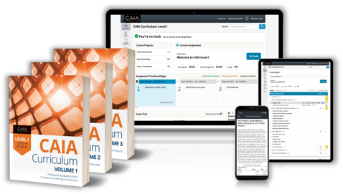
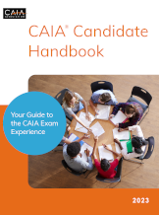

Curriculum & Study Tools
Other critical
readings and tools
Curriculum
CFA Standards of Practice Handbook
Download at CAIA.org
CAIA Sample Questions
Access at CAIA.org
Exam Registration includes access to the Digital Curriculum
CAIA Handbook
Download at CAIA.org
CAIA LI Study Guide
Download at CAIA.org
Notes:
On the Curriculum & Study Tools page, you will see links to purchase the textbook hard copy or eBook but will also see a new Digital Platform package offering. This package includes a digital copy of the textbook, the downloadable items and other nice tools to enhance your study experience, with organization and keeping you on track, all in one place. There is even a 14 free trial you can take advantage of, to test drive before purchasing.
Study Guide – Walks you through the core textbook and Standards of Practice Handbook stating key terms and Learning Objectives for topics covered.
Workbook- For additional practice involving content
Sample Exam- which will help you become familiar with the structure and format of the CAIA Level II exam, both Multiple Choice and Constructive Response formats.
Candidate Handbook- that provides all the information related to the enrollment and exam process and is an important resource.

Slide 5
CAIA Curriculum
Level I:
The Analyst’s Approach
  Introduction to Alternative Investments
  Hedge Funds and Managed Futures
  Commodities and Real Assets
  Structured Products and Credit Derivatives
  Private Equity, Private Debt, and Venture Capital
Level II :
The Allocator’s Approach
Ethics, Regulation, and ESG
Models and Methods
Investors and Investment Policy
Risk Management and Asset Allocation
Due Diligence and Manager Selection
Emerging Topics
Notes:
Curriculum changes for CAIA Level I
With the Fall 2020 Level I exam cycle, the Alternative Investments: CAIA Level I, 3rd Edition book has been revised and updated to reflect the evolution of the AI landscape. Following is a brief summary of the changes appearing in the 4th edition:
Redesigned curriculum focus: The level I and level II curriculum have been redesigned to provide a clear distinction between the two levels. In level I, we consider each of the alternative asset classes and strategies in a standalone format focused on bottom-up analysis. Discussions regarding private equity and private debt, credit derivatives and structured products, hedge funds and managed futures, along with real estate, commodities and real assets focus on the characteristics of each specific investment. The quantitative material in level I has been redesigned to focus on single variable methods to support the studies of standalone asset classes.
Updated, current content: Examples and market data have been updated. Substantially increased exposure to the rapidly growing area of private credit has been incorporated. Material on commodities, real estate assets and debt, and private equity assets are substantially new material for the level I curriculum.
Curriculum changes for CAIA Level II
With the Spring 2021 Level II exam cycle, the Alternative Investments: CAIA Level II, 3rd Edition book has been revised and updated to reflect the evolution of the AI landscape. Following is a brief summary of the changes appearing in the 4th edition:
Redesigned curriculum focus: The level I and level II curriculum have been redesigned to provide a clear distinction between the two levels. In level II, we consider the role of asset allocators at institutional investors such as pensions, sovereign wealth funds, endowments and foundations, as well as family offices. Rather than focusing on the stand-alone characteristics of each alternative asset class and strategy, the level II curriculum focuses on top-down portfolio construction issues, such as multivariate models and methods, access, risk, and due diligence. Asset allocation and portfolio management in a multiple asset portfolio are key concepts.
Updated, current content: Examples and market data have been updated. All new chapters on environmental, social, and governance (ESG) based investing have been added. In the ethics section, rather than repeating the CFA code and standards used at level I, candidates will now consider the CFA asset manager code. Other all-new chapters include access through private structures; the risk and performance of private and listed assets; investment process and due diligence; and risk measurement, risk management, and risk systems.

Slide 6
Future Curriculum Cycle Updates
Future Update Summary
Annual Revision available October for following full-year exam cycle
10-20% revised each year
Digital curriculum: Access for 18 months from date of purchase; can be updated for retakes
Print curriculum: Must be replaced in October of prior year for March or September retakes
The study guide is incorporated into digital and print curriculum materials and is also available for free review at caia.org.
Example:
September 2023 exam takers will purchase Level I or Level II curriculum materials on or after March 2023.
Materials will be relevant through the September 2023 exam window.
Digital materials from Wiley eLearning can be updated through 18 months (e.g., If Level I purchased in June 2023, it can be updated for the March 2024 exam after October 2023).

Slide 7
Exam Topics & Format
LEVEL I
  Professional standards & ethics
  Introduction to major areas of alternatives
  200 Multiple Choice Questions
    Section 1 : 100 questions, 120 minutes
    Section 2 : 100 questions, 120 minutes
Level I Topic | Approximate Exam Weight
Professional Standards and Ethics | 15%-25%
Introduction to Alternative Investments | 20%-28%
Real Assets | 11%-17%
Private Securities | 12%-20%
Hedge Funds | 11%-17%
Structured Products | 10%-14%
Notes:
Curriculum changes for CAIA Level I
With the Fall 2020 Level I exam cycle, the Alternative Investments: CAIA Level I, 3rd Edition book has been revised and updated to reflect the evolution of the AI landscape. Following is a brief summary of the changes appearing in the 4th edition:
Redesigned curriculum focus: The level I and level II curriculum have been redesigned to provide a clear distinction between the two levels. In level I, we consider each of the alternative asset classes and strategies in a standalone format focused on bottom-up analysis. Discussions regarding private equity and private debt, credit derivatives and structured products, hedge funds and managed futures, along with real estate, commodities and real assets focus on the characteristics of each specific investment. The quantitative material in level I has been redesigned to focus on single variable methods to support the studies of standalone asset classes.
Updated, current content: Examples and market data have been updated. Substantially increased exposure to the rapidly growing area of private credit has been incorporated. Material on commodities, real estate assets and debt, and private equity assets are substantially new material for the level I curriculum.
Curriculum changes for CAIA Level II
With the Spring 2021 Level II exam cycle, the Alternative Investments: CAIA Level II, 3rd Edition book has been revised and updated to reflect the evolution of the AI landscape. Following is a brief summary of the changes appearing in the 4th edition:
Redesigned curriculum focus: The level I and level II curriculum have been redesigned to provide a clear distinction between the two levels. In level II, we consider the role of asset allocators at institutional investors such as pensions, sovereign wealth funds, endowments and foundations, as well as family offices. Rather than focusing on the stand-alone characteristics of each alternative asset class and strategy, the level II curriculum focuses on top-down portfolio construction issues, such as multivariate models and methods, access, risk, and due diligence. Asset allocation and portfolio management in a multiple asset portfolio are key concepts.
Updated, current content: Examples and market data have been updated. All new chapters on environmental, social, and governance (ESG) based investing have been added. In the ethics section, rather than repeating the CFA code and standards used at level I, candidates will now consider the CFA asset manager code. Other all-new chapters include access through private structures; the risk and performance of private and listed assets; investment process and due diligence; and risk measurement, risk management, and risk systems.

Slide 8
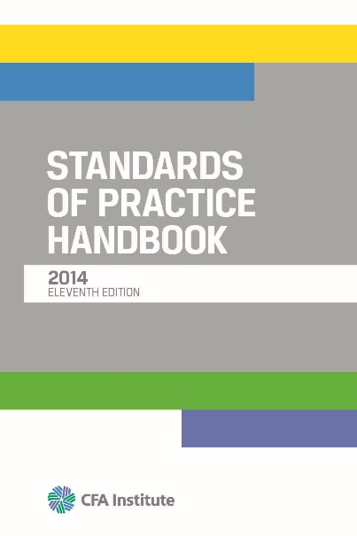
Level I – Exam Topics
Professional Standards and Ethics
READING:
Standards of Practice Handbook.
11th Edition, CFA Institute. 2014
    The practices and standards for ethical considerations experienced in the investment profession on a daily basis.
TOPICS:
  Standard I: Professionalism
  Standard II: Integrity of Capital Markets
  Standard III: Duties to Clients
  Standard IV: Duties to Employers
  Standard V: Investment Analysis, Recommendations, and Actions
  Standard VI: Conflicts of Interest
Introduction to Alternative Investments
Real Assets
Private Equity
Hedge Funds
Structured Products

Slide 9
Level I – Exam Topics
Professional Standards and Ethics
READING:
2023 CAIA Curriculum
Topic 2 – Introduction to Alternative Investments
What Is an Alternative Investment?
The Environment of Alternative Investments
Quantitative Foundations
Statistical Foundations
Financial Economics Foundations
Derivatives and Risk-Neutral Valuation
Measures of Risk and Performance
Alpha, Beta, and Hypothesis Testing
Introduction to Alternative Investments
Real Assets
Private Equity
Hedge Funds
Structured Products

Slide 10

Level I – Exam Topics
Professional Standards and Ethics
READING:
2023 CAIA Curriculum
Topic 3 – Real Assets
Natural Resources and Land
Commodities
Other Real Assets
Real Estate Assets and Debt
Real Estate Equity
Introduction to Alternative Investments
Real Assets
Private Equity
Hedge Funds
Structured Products

Slide 11

Level I – Exam Topics
Professional Standards and Ethics
READING:
2023 CAIA Curriculum
Topic 4 – Private Securities
Private Equity Assets
Private Equity Funds
Private Equity Fund of Funds
Evolution of Investing in Private Equity
Private Credit and Distressed Debt
Introduction to Alternative Investments
Real Assets
Private Equity
Hedge Funds
Structured Products

Slide 12

Level I – Exam Topics
Professional Standards and Ethics
READING:
2023 CAIA Curriculum
Topic 5 – Hedge Funds
Structure of the Hedge Fund Industry
Macro and Managed Futures Funds
Event-Driven and Relative Value Hedge Funds
Equity Hedge Funds
Funds of Hedge Funds
Introduction to Alternative Investments
Real Assets
Private Equity
Hedge Funds
Structured Products

Slide 13

Level I – Exam Topics
Professional Standards and Ethics
READING:
2023 CAIA Curriculum
Topic 6 – Structured Products
Introduction to Structuring
Credit Risk and Credit Derivatives
CDO Structuring of Credit Risk
Equity-Linked Structured Products
Introduction to Alternative Investments
Real Assets
Private Equity
Hedge Funds
Structured Products

Slide 14
Level I – Exam Topics
Professional Standards and Ethics
  SAMPLE QUESTIONS
  Which of the following are common definitions of distressed debt?
  I. Debt that trades at less than half of its principal value
  II. Debt with yield to maturity of 1,000 or more basis points above the riskless rate
  III. Debt rated as CCC or lower by Standard and Poor’s
  IV. Debt with annualized yield volatility in excess of 20%
    a. II, III, and IV only
    b. I, III, and IV only
    c. I, II, and IV only
    d. I, II, and III only
  What characteristic of mezzanine investing allows an investor to purchase the senior debt once it has been repaid to a certain level?
    a. Priority of payment
    b. The takeout provision
    c. Acceleration
Introduction to Alternative Investments
Real Assets
Private Equity
Hedge Funds
Structured Products

Slide 15
Level I – Exam Topics
Professional Standards and Ethics
  SAMPLE QUESTIONS
  An analyst is evaluating the risk-return profile of Derek Fund. The fund combines diversified long and short positions in competitively-priced assets with very large simultaneous short positions in out of the money calls and puts. An analysis based on observations from an extended period characterized by relative market calmness is most likely to suggest which of the following return characteristics for Derek Fund?
  a. High alpha and platykurtosis
  b. High alpha and leptokurtosis
  c. Negative alpha and platykurtosis
  d. Negative alpha and leptokurtosis
  Luke’s Locker Corporation has made an offer to purchase RBM Corporation for $30 per share. Immediately prior to the announcement, RBM was trading at $15 per share. Directly after the initial announcement, the share price of RBM Corporation moves up to $25 per share. Assume that RBM’s share price would fall back to $12 per share if the deal does not go through. Further assume a riskless interest rate of 0%, for simplicity. Lucas Hedge Fund, an event-driven hedge fund, takes a long position in RBM Corporation and takes a binary call option view of event strategy returns. Viewing the transaction this way, what is the face value of the long position in the riskless bond, and the potential payout on the call option in the case of a successful merger, respectively?
  a. $0 and $30
  b. $12 and $18
  c. $15 and $15
  d. $25 and $5
Introduction to Alternative Investments
Real Assets
Private Equity
Hedge Funds
Structured Products

Slide 16

Candidate
Experience
Optimize Your Exam Experience
Your CAIA Profile
Obtain your Curriculum
Schedule Your Exam Seat
Study Resources
Notes:
Hello again, I’m Kathy Lyons, Candidate Relations Manager, and I’d like to answer some commonly asked questions.
In a few minutes, at the conclusion of this section, we will be turning the presentation over to you, the participants, to review your questions.
Please continue to send your questions at any time to us via the Q & A panel to the right of your screen.
A recording of this session will be made available on our website within a week or so.

Slide 17
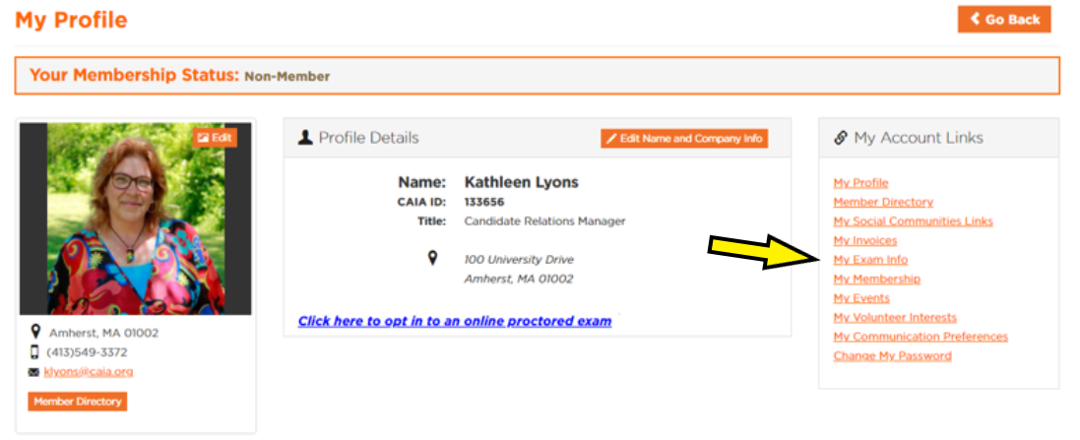
Your CAIA Journey
Optimize your CAIA Exam Experience
Your CAIA Profile is your central command
Keep your Account profile up to date.
Our team & Test Partner Pearson keep you informed via email

Slide 18
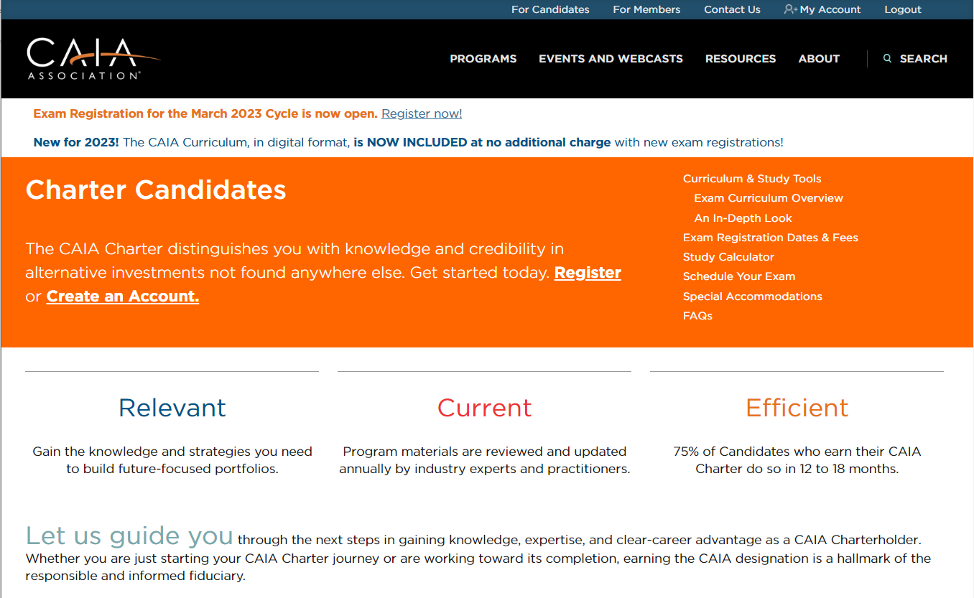
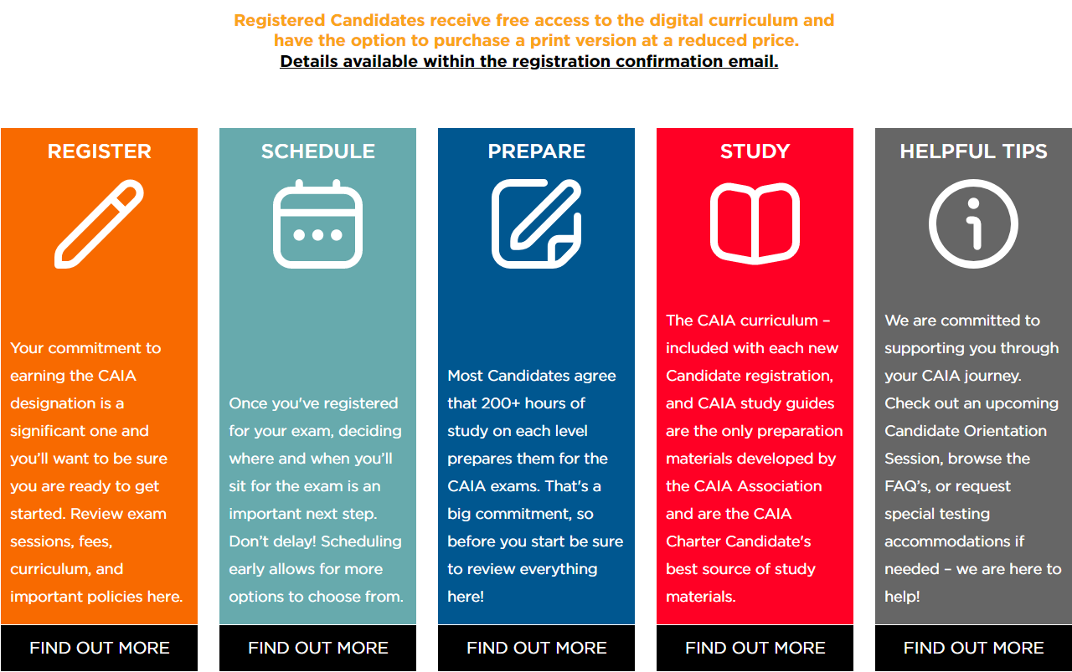
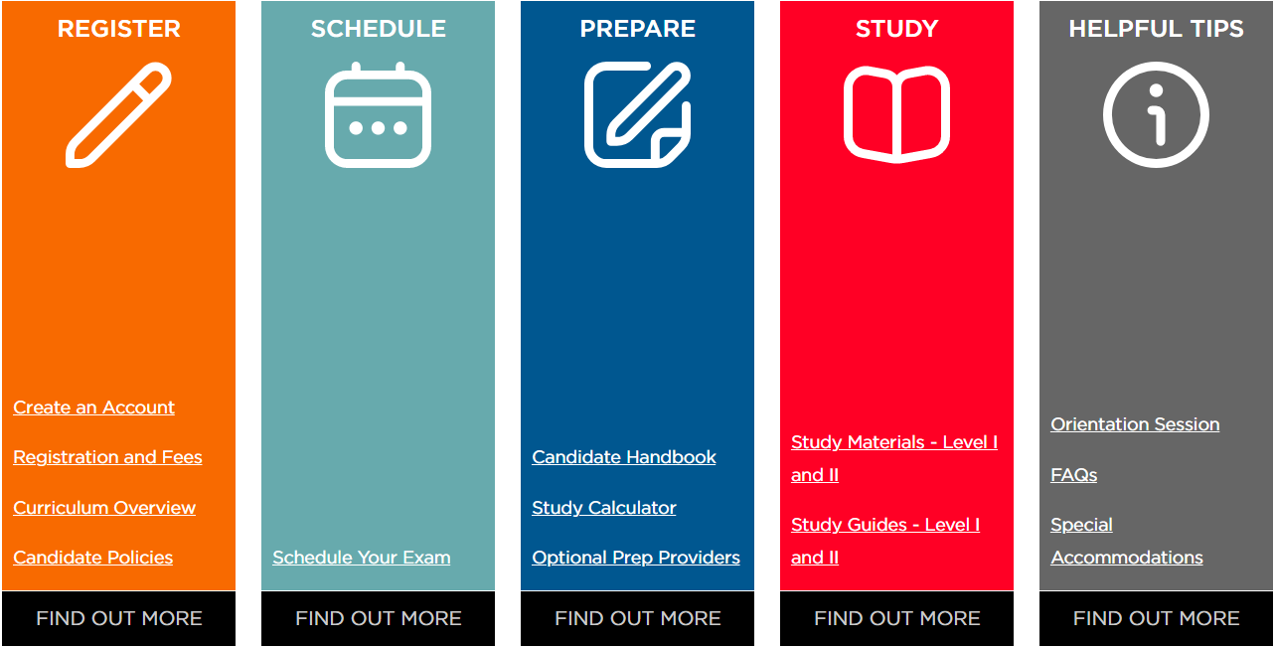
Your CAIA Journey
Candidate Resources
Register as a candidate
Schedule your exam seat
Prepare your learning journey
Study for your exam day
Notes:
The Charter Candidates page is really your best friend. You can access this page by clicking on “For Candidates” at the very top of the screen. Once landed there you will see many white links to the right of the opening paragraph, for Preparing, Curriculum and Study Tools, finding a test center and when the time comes, if not already done, to Schedule Your Exam appointment. The FAQs is a great resource as well for additional questions you may have. The 3 boxes below the opening paragraph are also active links. The Registration and Fees box will take you to see all the fees, Exam session information and the discount information to enter for Association Partners if you are eligible. Elaborate… employer company must be a Member…

Slide 19
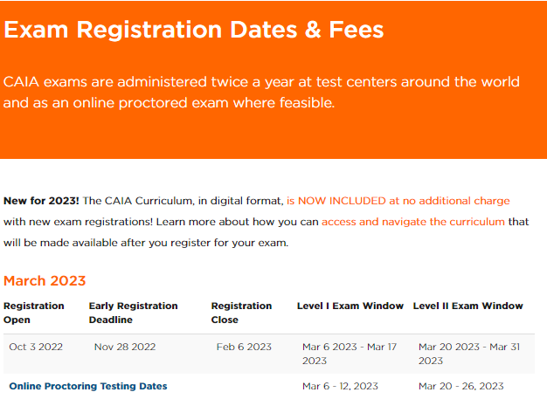
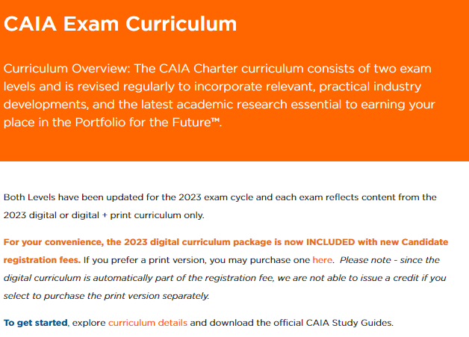
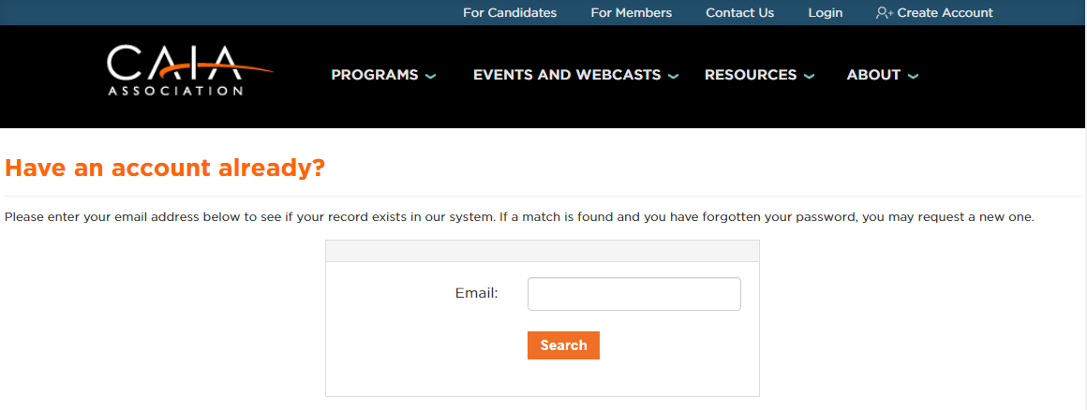
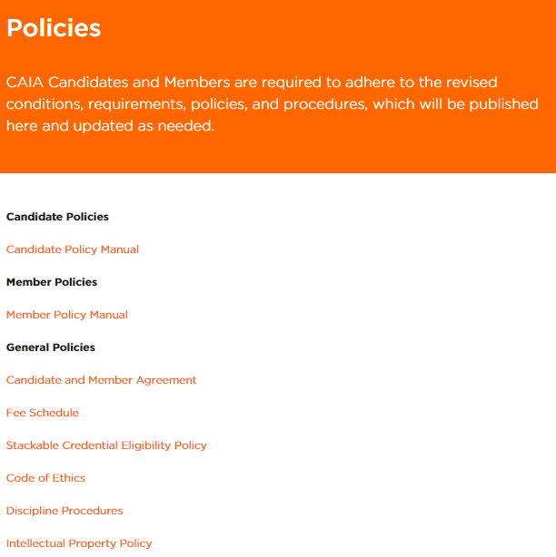
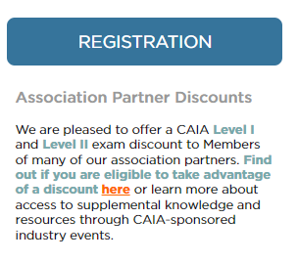
Register
*Retake fees will remain at $450 for the March 2023 exam session. Beginning with the September 2023 exam session, retake fees will increase to new fee structure of $795.
Create an Account
Registration & Fees
Curriculum Overview
Candidate Policies
Notes:
The Preparing Menu is a great resource to accomplish a lot of the tasks needed leading up to exam day. From this page you can Register for an exam session, Schedule/reschedule exam appointment, Access the Curriculum and Study Tools, Register for or review a recording of Candidate Orientations, Review 3rd Party Prep Provider offerings. Elaborate

Slide 20
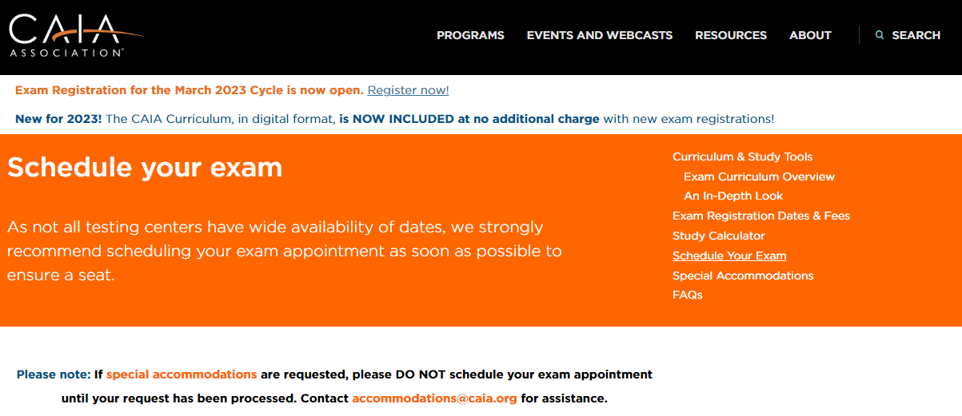
Schedule: Testing Options
There are two options to take the CAIA Exam:
Option 1: At Pearson VUE Testing Center*
Please wait one hour after registering for your exam before attempting to schedule your test center appointment.
Option 2: Online remote proctored exam via OnVUE**
Before selecting the OnVUE option, please review information about this option available
Critical - carefully read the OnVUE physical and system requirements and determine if you meet the requirements.
Opt-in for online proctoring using the link in your CAIA profile
Create an Account
Schedule Your Exam
Tips!
Schedule your exam as soon as possible
First come, first serve
Can’t find a seat? Contact us candidate@caia.org
Try to schedule at the beginning of the test window
Notes:
There are two options to take the CAIA Exam:
Option 1: At Pearson VUE Testing Center*
Please wait one hour after registering for your exam before attempting to schedule your test center appointment.
Option 2: Online remote proctored exam via OnVUE**
Before selecting the OnVUE option, please review information about this option available
Critical - carefully read the OnVUE physical and system requirements and determine if you meet the requirements.
Opt-in for online proctoring using the link in your CAIA profile

Slide 21


Schedule: Testing Options
Option 1:
Testing at a Person Vue Test Center
Option 1:
Online Remote testing via OnVue
Create an Account
2-part exam
  5-minute NDA review and agreement
  5-minute Tutorial
  Part 1: 100 multiple choice questions/120 minutes
  Optional 10-minute comment period
  30-minute optional break, can leave testing room
  Part 2: 100 Multiple choice questions/120 minutes
  Optional 10-minute comment period
  Total 5 hours
2-part exam
  5-minute NDA review and agreement
  5-minute Tutorial
  Part 1: 100 multiple choice questions/120 minutes
  .
  20-minute optional break, this is the only time you can leave the view of webcam
  Part 2: 100 Multiple choice questions/120 minutes
  .
  Total 4.5 hours
Notes:
How does the structure of the Exam differ?

Slide 22
Schedule: Testing Options
Option 1:
Testing at a Person Vue Test Center
Option 1:
Online Remote testing via OnVue
Create an Account
Controlled test site environment (Pearson VUE COVID protocols in place)
Onsite exam proctors monitoring Candidates in testing room
Center availability
Awareness of updated Pearson VUE COVID-19 protocols
Schedule early in the exam window in case of any disruption
Safe, secure, private, quiet personal location of your choosing
Minimum Equipment and Internet requirements must be met
Proctor monitors Candidates via webcam
Time to prepare
Review minimum system requirements and run system test
Schedule early in the exam window in case of a technical issue
Notes:
What is the ONVUE exam -- Speak to differences going to a center vs. a center in your home/private location

Slide 23
Schedule: Testing Options
Option 1:
Testing at a Person Vue Test Center
Option 1:
Online Remote testing via OnVue
Comparing Your Options | Pearson VUE Test Center | Online Remote Testing
Calculator | Candidates may only use a CAIA approved calculator. See Candidate Handbook at www.caia.org
Whiteboard | Dry erase board and pen are provided | Digital whiteboard ONLY, online scratch pad within exam
Un-scheduled breaks | Yes, for bathroom use only and may be escorted. Time lost. | No.
What can I bring into the testing space | Approved calculator, ID, locker key. A small locker will be available for personal items. | One clear glass of water, approved calculator, cell phone for check in purposes, then it must be out of reach.
Accommodations | Available upon request to accommodations@caia.org | Available but may be more limited, upon request to accommodations@caia.org
Notes:
Comparing the two modalities
The CANDIDATE HANDBOOK.
You will need to bring a calculator to both of the CAIA examinations. The CAIA Association allows candidates to bring into the examination the Texas Instruments BA II Plus (including the TI BA II Plus Professional) Hewlett Packard 12C (including the HP 12C Platinum, HP 12C 25th Anniversary Edition, HP 12C 30th Anniversary Edition, and HP 12C Prestige), per the CAIA Examination Calculator Policy.

Slide 24
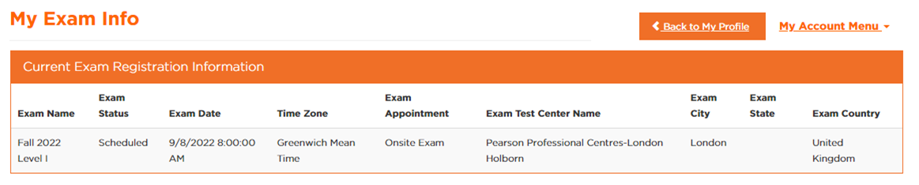
Your Appointment Details
Create an Account
Notes:
The Preparatory Program Providers have their own web page under the CAIA Chartered Candidate’s menu. Because we are not affiliated with preparatory program providers and have no control over their materials, we cannot offer any feedback on their quality, however approximately 50% of candidates do choose to use them in addition to the CAIA curriculum. These are meant to be “Supplemental Materials” and not to replace the CAIA Curriculum! Can’t stress this enough. Click on any one of their logos to be taken to their website and view what they have to offer for sale.

Slide 25
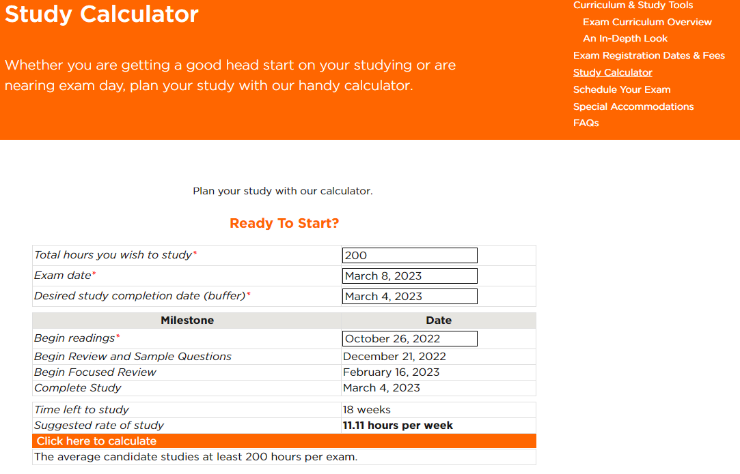
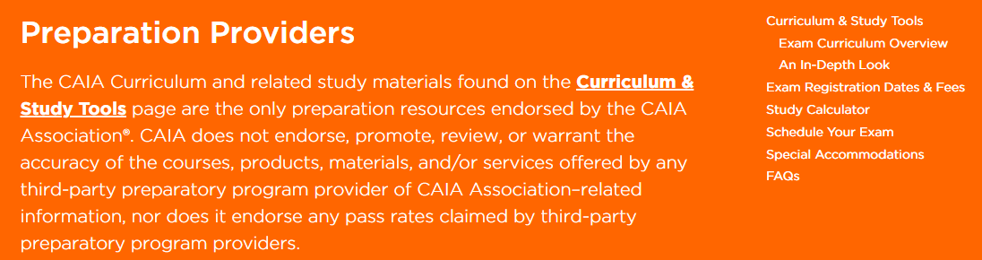
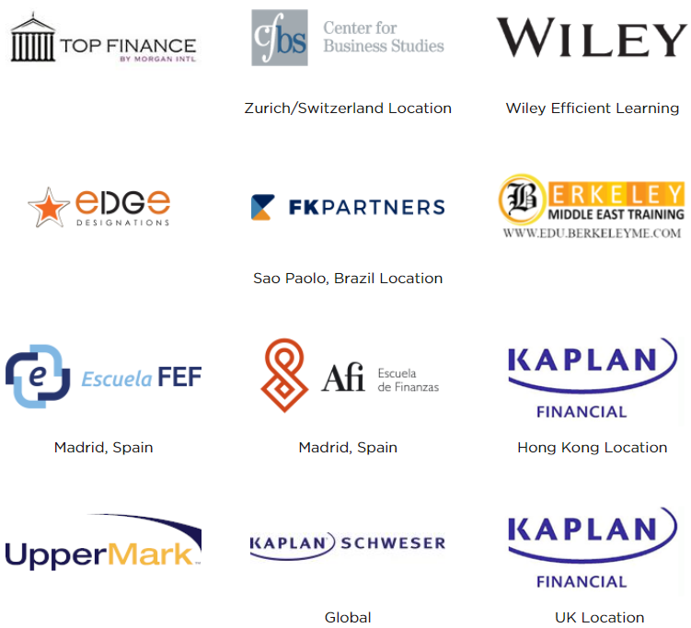
Prepare
Candidate Handbook
Study Calculator
Optional Prep Providers
CAIA Handbook
Download at CAIA.org
Notes:
The Preparing Menu is a great resource to accomplish a lot of the tasks needed leading up to exam day. From this page you can Register for an exam session, Schedule/reschedule exam appointment, Access the Curriculum and Study Tools, Register for or review a recording of Candidate Orientations, Review 3rd Party Prep Provider offerings. Elaborate

Slide 26
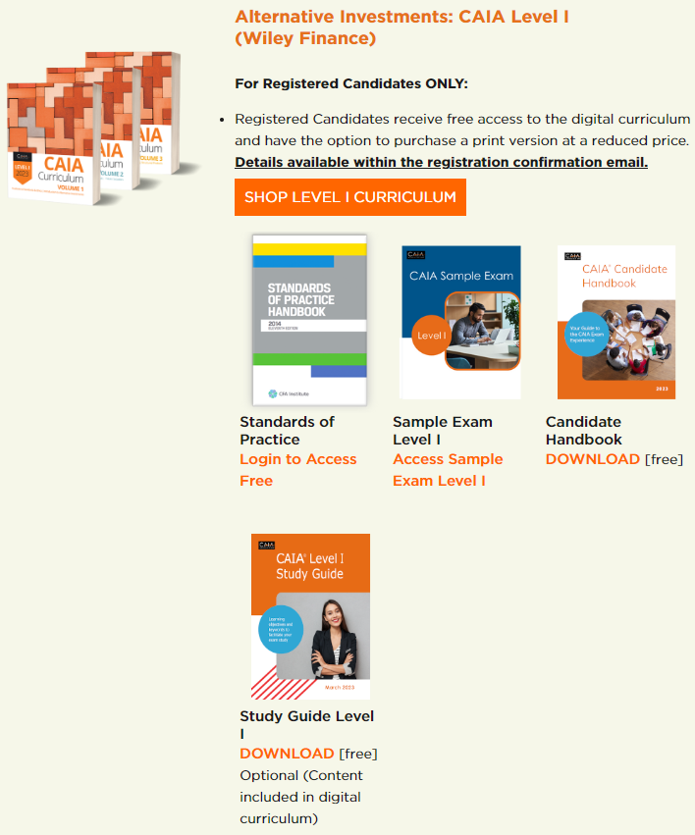
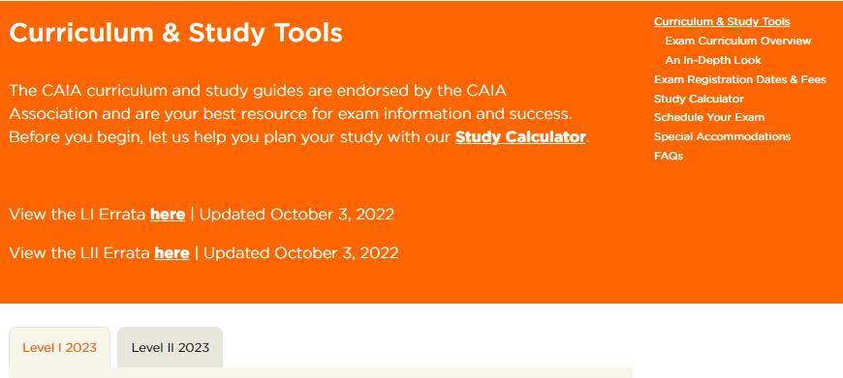
Study
Study Materials
Study Guide
Notes:
The Preparing Menu is a great resource to accomplish a lot of the tasks needed leading up to exam day. From this page you can Register for an exam session, Schedule/reschedule exam appointment, Access the Curriculum and Study Tools, Register for or review a recording of Candidate Orientations, Review 3rd Party Prep Provider offerings. Elaborate

Slide 27
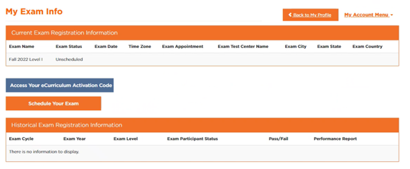
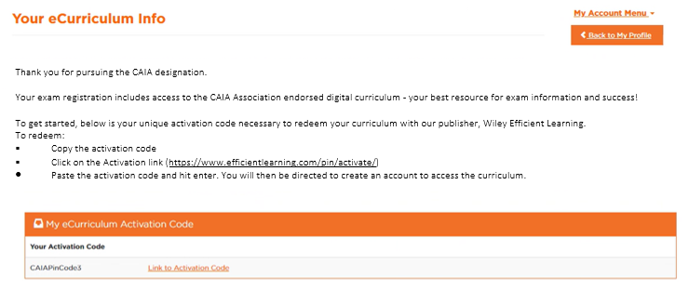
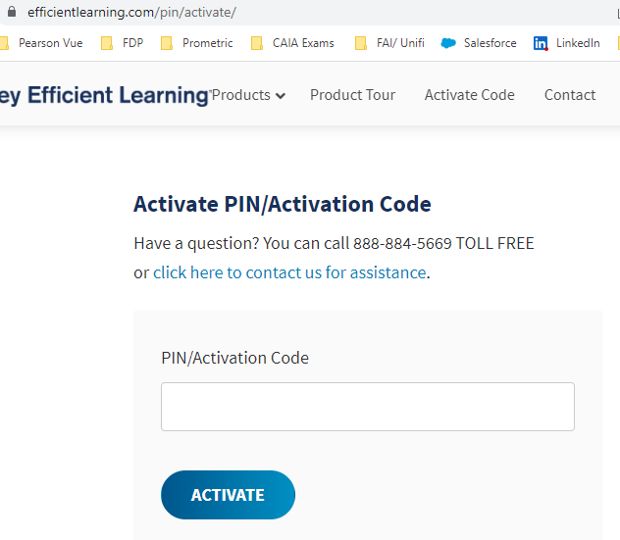
Obtain Your Curriculum
Study Materials
Study Guide

Slide 28

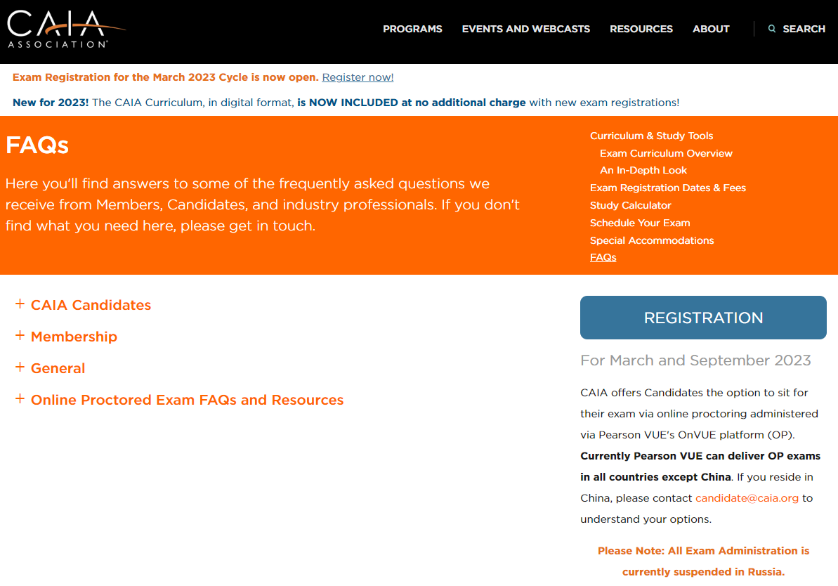
Helpful Tips
Orientation Sessions
Frequently Asked Questions
Special Accommodations
www.caia.org/https://caia.org/orientation-sessions
A copy of todays slide deck and a link to the recording will soon be available.
Notes:
The Preparing Menu is a great resource to accomplish a lot of the tasks needed leading up to exam day. From this page you can Register for an exam session, Schedule/reschedule exam appointment, Access the Curriculum and Study Tools, Register for or review a recording of Candidate Orientations, Review 3rd Party Prep Provider offerings. Elaborate

Slide 29

Exam Day
Create an Account
ID POLICY
  Two valid (not expired) forms of ID (1 Primary ID required for online proctored exam)
  Both must have a signature
  One must have a photo
  Passport preferred
  The name on your IDs must exactly match the name with which you schedule your exam.
CALCULATOR POLICY – For both test site and online proctored options
  Texas Instruments BA II Plus (including the TI BA Plus Professional)
  Hewlett Packard 12C (including the HP 12C Platinum, HP 12C 25th Anniversary Edition, HP 12C 30th Anniversary edition and HP 12C Prestige)
  Exam proctors will inspect your calculator prior to the start of the exam.
Notes:
There are two policies we want to remind you of before you arrive to the testing center on exam day: the Identification Policy and the Calculator Policy.
The Pearson VUE Identification policy requires test-takers to have 2 valid forms of ID: both need to have a signature and one should have a photo. The name on your IDs must exactly match the name with which you scheduled your exam. If you bring an ID with a name other than the one that Pearson VUE has on file for you, then they will not allow you into the testing center. For a full list of acceptable forms of ID review the ID policy on our website.
Also, there is a calculator policy. Candidates are only allowed to bring specific models of calculator into the exam centers: the Texas Instruments BA II Plus (including the professional model) and the Hewlett Packard 12C (including the Platinum edition). Pearson VUE exam proctors will require any stored memory be cleared prior to the start of the exam. Make sure you are familiar with adjusting your settings as they will most likely be cleared as a result. Also mention the eye glass and tattoo review policies. Both will be visually inspected. Do not be offended when asked.

Slide 30
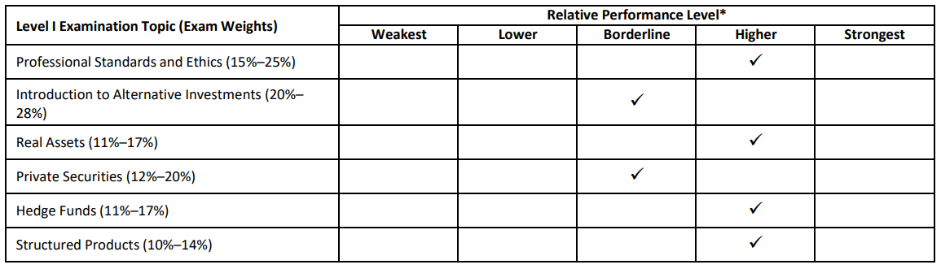
Candidate Performance Report
The CAIA Candidate Performance Report is intended to aid in self-assessment by indicating your areas of relative strength and weakness among the topics in the exam, compared to a reference group.
The reference group is comprised of all candidates whose total test scores were within the bottom quartile of those who passed the exam during the testing window in which you sat for the exam.
Grades are shared 5 weeks after the last LI exam day.
Notes:
Level I exam results are generally available within 3 weeks from the last examination day of the Level I exam window. When your results are released, you will receive an email notification letting you know the results have been uploaded to your CAIA account and instructions to locate them from your main profile page. In addition to discovering whether you passed or failed, you will receive the Candidate Performance Report. This report places candidates’ scores in buckets according to relative performance level. The reference group is comprised of all candidates whose total test scores were within the bottom quartile of those who passed the exam during the testing window in which you sat for the exam. There is a thorough explanation of how to interpret your candidate performance report in the Candidate Handbook, I believe beginning on page 17.

Slide 31



Your success is our success
Roadmap: Prepare for Your CAIA Exam
In preparation of your CAIA Exam,
our team weekly shares
3 INSIGHTS | 2 TIPS | 1 ACTION ITEM
Check your email
Best of luck with exam preparations!
If you have additional questions,
please contact us at candidate@caia.org.

Slide 32



Stay Connected.
Caia.org
candidate@caia.org
@CAIAAssociation
linkedin.com/CAIA_Association

Slide 33
Today’s Presenters
Steve Novakovic
Managing Director, CAIA Curriculum
CAIA Association
Kathy Lyons
Sr. Candidate Relations Manager
CAIA Association
Aleeza Amador
Candidate Relations Associate
CAIA Association
¡Yo hablo español!
Part I
Exam Experience
Part II
Candidate Experience

